Slide 1

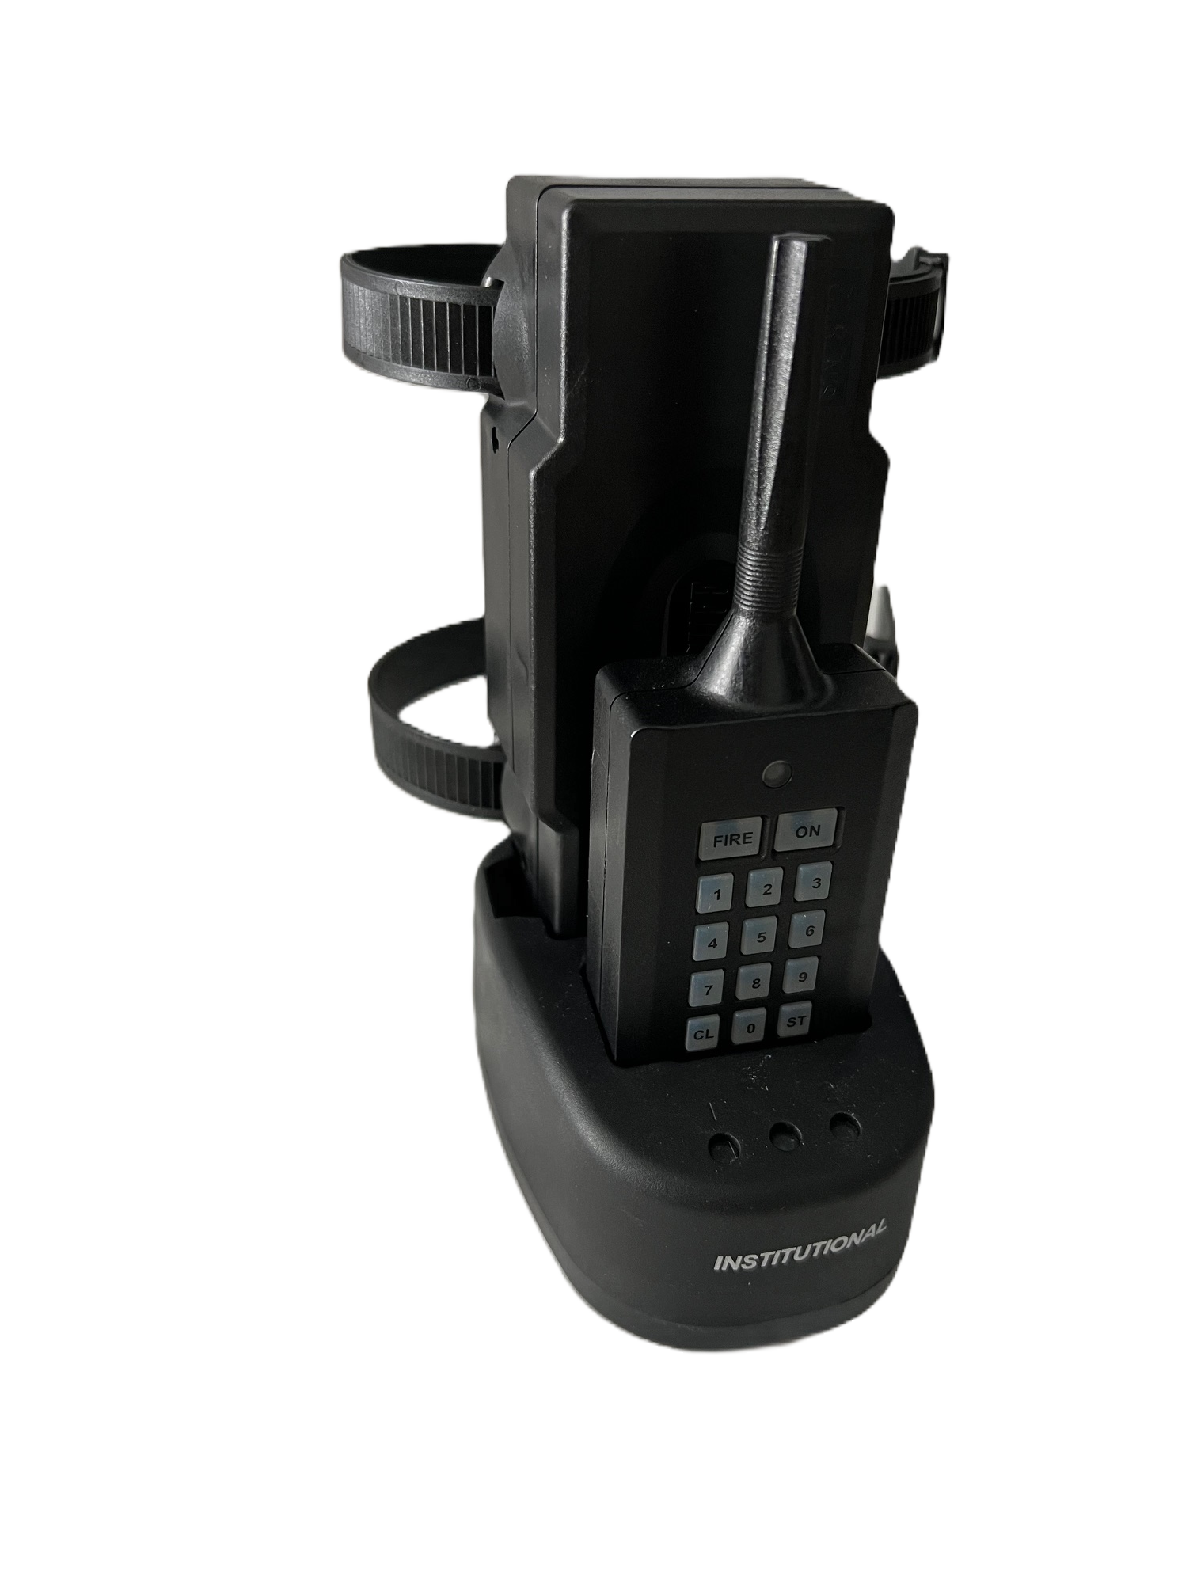
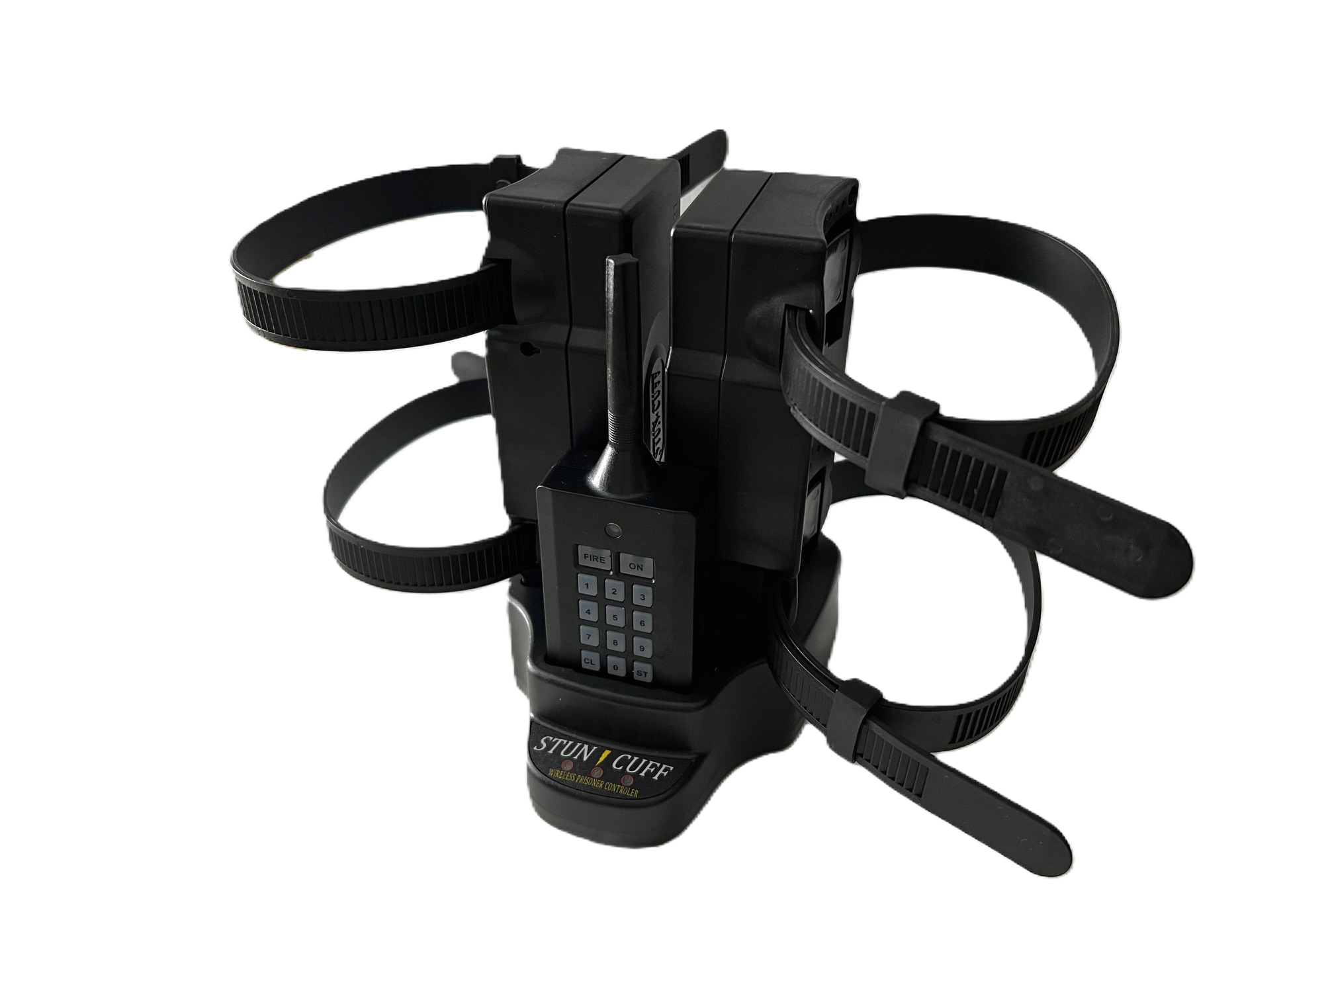
Institutional

Slide 2
Performance Objectives
Understand the technology and operating principles of the Stun-Cuff
Understand the application and expected effect of use on Offenders
Understand and review applicable Use of Force Policies

Slide 3
Performance Objectives Cont.
Be aware of use/ effects of the technology on offenders where certain medical conditions/ considerations may exist
Understand post incident procedures following activation and firing of the Stun-Cuff

Slide 4
Stun-Cuff Institutional System
Institutional Cuff (can be a single or dual cuff system)
Transmitter: Standard, Dual Cuff or Multi-Cuff
Charging Base
Carrying Case
Notes:
The Stun-Cuff system is intended to provide a safe and effective restraint and deterrent for use in court or the transport of prisoners. It is intended to reduce the risk of prisoner violence and the degree of physical force by officers. The Institutional System comprises of the Institutional cuff which can be a single or dual cuff system, transmitter, charging base and carrying cases. The Institutional cuff is a wireless Stun-Cuff that provides users with the ability to download data regarding each firing, date, time and duration. The single system comes with a standard transmitter which can control one cuff. The dual cuff system will come with the dual cuff transmitter which controls both cuffs simultaneously. There is also a multi-cuff transmitter that allows one individual the ability to control up to nine stun-cuffs. One charging base for both the transmitter and cuff(s) which will turn from Red to Green when they are charged. There is a duty belt holster for the cuff and the transmitter has a sleeve with clip.

Slide 5
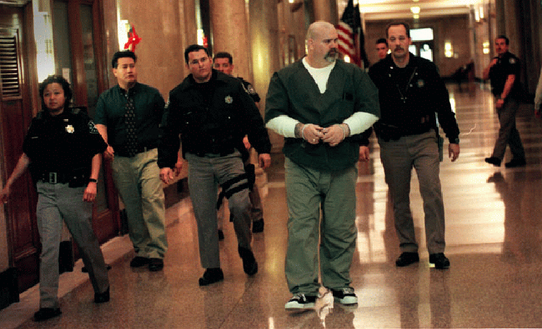
Why Use Stun-Cuff?
Light-weight unit
Can be re-activated after initial cycle
2 step activation process
Reduces the likelihood of a physical confrontation
Decreases the possibility of injury to both the Officer and the Offender
Notes:
Provided that the Stun-Cuff is used as intended within the Departments use of force guidelines and is objectively reasonable, the Stun-Cuff may result in reduced liability lawsuits and claims against officers and their agencies.

Slide 6
Training
Stun-Cuff products can only be used by those trained in accordance with department standards
Training should be documented
Recurring training should be established

Slide 7
Unit Capabilities
5-6 Seconds of approximately 50,000 Volts / 5 milliamp output
Can reactivate w/in 10 seconds of initial stun
Activator will produce a longer stun if needed
Activator will produce multiple stuns on demand
Approximately 100 yard range

Slide 8
Operational Capabilities
Battery can last up to 7 days in stand-by mode
Unit shows Green signal LED (flashes every 3 seconds in stand-by mode) / Red LED at low power
Activate through barriers
2 step fail safe operation
100 yard range
Maintains log of use (time, date, length of firing)
Can only be placed on the leg

Slide 9
Guidelines for Use
The Stun-Cuff is a device designed for the temporary, non-lethal incapacitation of a violent or resisting individual
The use of a Stun-Cuff will not violate a prisoner’s rights provided it is used as intended and within DOC use of force policy
Notes:
Activation of the Stun-Cuff would be considered “soft intermediate control devise.” Per DOC Use of Force Policy, staff are authorized to use the level of force that is necessary and reasonable, not excessive, and is appropriate when considering the type of resistance / non-compliance encountered.

Slide 10
Guidelines for Use Cont.
Any possible accidental activation must be avoided
The Stun-Cuff will not injure an offender; however, as with any use of force, secondary and indirect injuries can occur
Notes:
Barring a system malfunction, an accidental activation will be avoided given the attention and diligence of the staff handling the transmitter.
INSTRUCTOR: Discuss possible secondary/indirect injuries that may occur, ie. offender falling, etc.

Slide 11
Guidelines for Use Cont.
Application of any Electronic Incapacitation Device (EID) will leave marks
EIDs have a place in the traditional force continuum
Notes:
Use of Force Policy, all EID’s (electronic control devices) are considered “Soft Intermediate Control Devises.”
The use of force is restricted to instances of justifiable self-defense, protection of others, protection of property, implementation of lawful orders, and prevention of escapes, and then only as a last resort to maintain and regain control in accordance with appropriate statutory authority.
Staff must be able to defend the decision to utilize “multiple applications” of the Stun Cuff.

Slide 12

Levels Of Resistance
Psychological Intimidation
Verbal Non-Compliance
Passive Resistance
Defensive Resistance
Active Aggression
Deadly Force Assault
Escape
Notes:
Briefly review Levels of Resistance and have class give examples of each.

Slide 13

Options Of Control
Officer Presence
Verbal Direction
Soft Empty Hand Control
Hard Empty Hand Control
Soft Intermediate Control Device
Hard Intermediate Control Device
Lethal Force
Notes:
Briefly review Options of Control and have the class give examples of each.
Discuss possible scenarios where activation of the Stun Cuff would be appropriate….not appropriate.

Slide 14
Why Use The Stun-Cuff On Offender Transports?
Reduces physical confrontation
Decreases resistance
Impairs an offender
Decreases injury potential
For larger transports, the multi-cuff transmitter can control up to 9 cuffs / offenders
Notes:
Reduces physical confrontation
Decreases resistance after a physical confrontation
Impairs an offenders ability to effectively resist
Decreases the potential for injury
With the multi-cuff transmitter the cuffs can be fired independently or simultaneously if needed

Slide 15


Using The Stun-Cuff
Court
Hospital / Medical Supervision
Transports
Extraditions
Notes:
Only staff who have completed the training for the stun cuff and have successfully passed the test are allowed to use and activate the device on any offender.
2. Staff who have not completed the training are not allowed to handle the device,

Slide 16
When To Use the Stun-Cuff
When can the Stun-Cuff be applied to an offender?
Notes:
The stun cuff can be used on any segregation offender based on the reason they are in segregation and with the shift commanders approval.
If an offender is going to court and the judge orders for all restraints to be removed the stun cuff can be concealed under the offenders pant leg and not visible to the jury.
Any high risk offender that has a history of escape and assaults on staff or any offender with the shift commanders approval .
Use would be justified on a prisoner who pulls away from his escort, refuses to comply, who pulls away and begins to act out, or voices a credible threat.
Ensure you have proper approvals.

Slide 17
When To Use the Stun-Cuff
What classification levels require the Stun-Cuff to be placed on the offender?
Notes:
The stun cuff may be used on all administrative segregation offenders being transported to court, medical appointments, or any off grounds day trips.
The stun-cuff may be used on other levels depending addition factors such as custody levels, behavioral patterns of violence or misconduct, etc.
Ensure you get proper approvals

Slide 18
Unauthorized Use
Any woman known or claiming to be pregnant
Any person that has or claiming to have a serious heart disease
Any person that has or claiming to have muscular dystrophy or multiple sclerosis
Conditions should be verified with Medical

Slide 19
Stun-Cuff Placement
Cuff should be placed on back of leg close to the achilles
Place cuff directly to skin or over sock
Standard handcuff key releases straps to open for placement and removing

Slide 20
Positioning - Leg
Placed directly to the skin or over the sock towards the achilles tendon
Charging contacts should be facing upward and away from the foot
Strap firmly but do not overly tighten
Notes:
Securing the strap firmly allows the electricity to “dance” on the skin for the best effect.

Slide 21
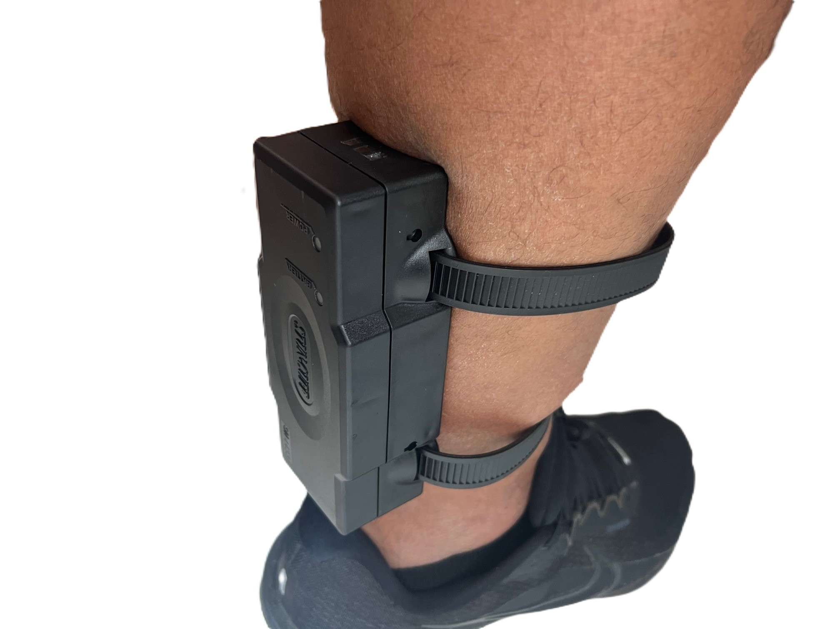
Charging contacts facing upward and away from the foot.
Notes:
Securing the strap firmly allows the electricity to “dance” on the skin for the best effect.

Slide 22
Turning The Device On
These steps are for the standard transmitter that comes with the single cuff system
Pass the bottom of the transmitter over the LED lights on the Stun-Cuff
The Green power light will come on
Press the “ON” button and hold until the Green light flickers
The Green LED light will flash every 2-3 seconds to show it is in “ON” mode or “Stand-by” mode
Notes:
*Once the Green LED flickers, the ON” button should be released. The “ON” button of the remote control must be pressed within 12 seconds of green power light coming on or the procedure must be started again. The green light will flash quickly and then go into power saving mode.
**If the power is low, the red Battery light comes on.

Slide 23
Activation / Firing
Proper method to activate the device for a shock test or for an actual use of force
To trigger an electrical shock, press the “ON” button
Press the “FIRE” button within 10 seconds of pressing the “ON” button
Holding the “FIRE” button down will cause an additional shock after the first 5-6 seconds
Another shock can be delivered if the initial delivery was less than 10 seconds
Notes:
Once the stun cuff has been turned on and placed into power safe mode, the staff member can conduct a shock test to show the offender how the device will look and sound.
Pressing the FIRE button will initiate an electronic shock, lasting 5-6 seconds.
The shock may continue for 5-6 seconds from the time the button is released.
Additional stuns can be delivered if needed and required
To administer a second shock, repeat activation steps above
There is no audible tone prior to the stun-cuff delivering the shock.
IMPORTANT: Loud, repetitive verbal commands must be utilized to direct the offender.
The longer the fire button is pressed the likelihood of more shocks but the voltage should stay the same.
When the electricity is weak the red Battery light comes on.
When firing the Stun-Cuff prisoner control device, remember that everyone has a different level of tolerance. The Stun- The Stun-Cuff gives an initial burst of electricity for 5-6 seconds – some people may require more. The longer the FIRE button is pressed, then additional shocks will be given. The Stun-Cuff has up to 10 minutes of fire power and an approximate range of 100 yards.

Slide 24
Deputies Taking Hits
https://stun-cuff.com/testimonials-and-news-reports/
Notes:
Towards top of page, far right side

Slide 25
Turning The Device Off
Once the cuff is no longer needed you need to turn the device off. These steps are for the standard transmitter that comes with the single cuff system
To turn off the stun-cuff press and hold the “ON” button for approximately 3 seconds till the Green LED power light flashes twice
Once the LED light flashes, release the “ON” button
Once the LED Green light flashes twice and then stops, the device is now off
Staff must verify the device LED is not flashing

Slide 26
Steps For Dual Cuff System
The steps for the dual cuff system are slightly different for turning on and off but activating/firing is the same
Once you have the Green power light on the Stun-Cuff, to turn it on press the “ON” button and then hold the “1” until the cuff flickers. To turn the second cuff on repeat step and hold the “2” button
To turn off the Stun-Cuffs it is the same process as turning them on. Press the “ON” button and then hold the “1” or “2” until the light flashes twice.

Slide 27
Instructional Videos
https://stun-cuff.com/stun-cuff-instructional-videos/

Slide 28
Charging
The transmitter and Stun-Cuff will need to be charged when the Green LED light turns Red on the cuff
LED lights on charging base will turn from Red to Green when the cuff and transmitter are fully charged
Batteries are good for 2-3 years depending on use and proper charging
Notes:
Only specific staff will be given the authorization to charge the device and the remote control.
Once the cuff and remote control have been placed on the charger the lights will be displayed at the front of the charger. If they are red leave the unit on and allow it to charge. Once both lights turn green the device is fully charged. Disconnect from power and leave the cuff and remote in the charging station.
The batteries must be replaced every two years to maintain the full ten minutes of shocking power.

Slide 29
Notification To The Offender
Read Inmate Notification to the offender
Offender does not have to sign
Stun-Cuff is placed on the offender regardless of the offenders signed acknowledgement
Notes:
Staff will read the notification to the offender to ensure they will understand the device going on them and what the possible effects are.
The offender does not have to sign the notification, if they refuse to sign notate the refusal on the notification.
The device will/can be placed on the offender without a signature.
GIVE STUDENTS “INMATE NOTIFICATION FORM” HANDOUT.

Slide 30

When To Activate
When can / should the Stun-Cuff be activated?
Notes:
Follow all polices and procedures concerning use of force and when dealing with a situation that may need the staff member to administer a shock to the offender.
Good strong verbal skills must be used in order to notify the offender and your fellow staff member of what may come.
Reason for possible activation are attempted escape, attempted assault to the staff member or other personal, attempting to remove or defeat the device, if staff loose sight of the offender with in the hospital setting. Remind staff the situation will dictate the outcome and tactics of each use of force.
Remind staff the totality of circumstances and their perception of the incident will play a major factor in the possible activation of the device.
The stun cuff will not have an audible tone before it administers the shock. The only warning that the offender will get is the loud verbal commands from the staff member controlling the remote control.
If staff are going to administer a shock to the offender they must be able to communicate to their fellow staff members so they may take control of the offender and restrain them from causing any further issues.

Slide 31
Steps After Activation
If the Stun-Cuff is activated what will / may happen and will signature marks be present?
What should staff do with the offender after a shock has been given?
Notes:
1. If staff do administer a shock of the stun cuff to the offender, the offender can/may loose control over balance, body fluids to include urine and possible self defecation.
2. Signature marks will be present immediately after the shock has been administered to the offender.
3. Once the control of the offender is regained - the offender must be returned back to the facility immediately.
4. If a shock has been administered (i.e. medical transport, court hearing, medical day trip, etc.), the Shift Commander must be notified immediately.
5. Ensure the restraints are all still properly placed on the offender and escort the offender back to the transport vehicle.
6. If at a court hearing get the offender to a secure location and notify the shift commander, a decision to deploy additional staff may be warranted.
7. Upon return an anatomical report must be completed by medical staff and a PC/DCIS report completed.

Slide 32
Incident Reporting
A PC/DCIS Report must be completed in accordance with Administrative regulation 100-07
Any staff report of injuries must accompany a First Report of Injury packet
Notes:
A PCDCIS report must be generated as soon as possible and a use of force report must be completed before the end of your tour of duty. AR 100-07.
All staff injuries, whether or not medical attention is being sought, must be reported to the Shift Commander or immediate supervisor.

Slide 33
Questions?

Slide 34
Knowledge Evaluations
Practical – Static Activation
Written Test
Notes:
Staff must show they can turn the device on, place it on power safe mode, activate the device and turn the stun cuff off. Along with taking the written test, 80% Pass/Fail.
At no time, may any class participant/staff person be subjected or forced to testing of the Stun-Cuff on themselves.

